Slide 1

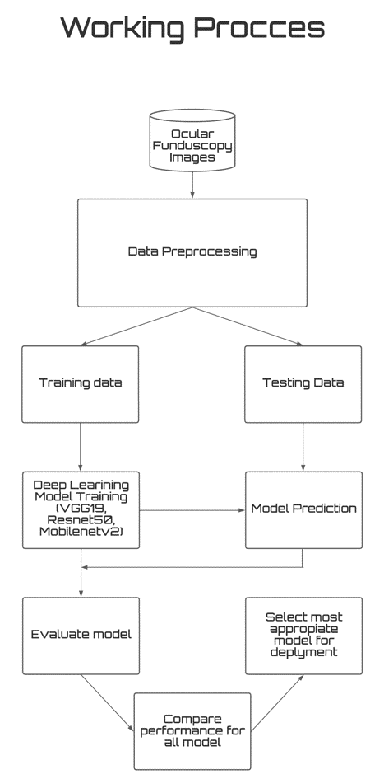
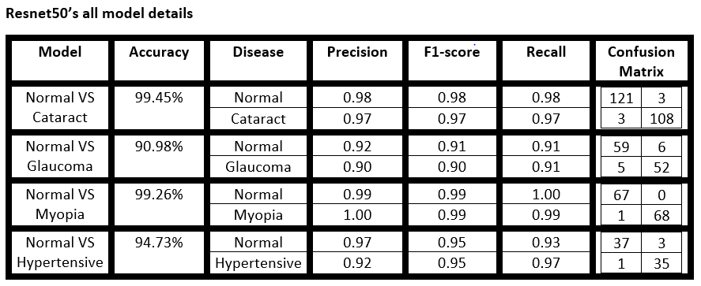
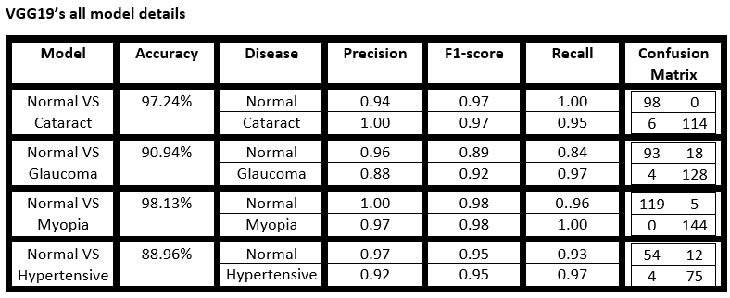
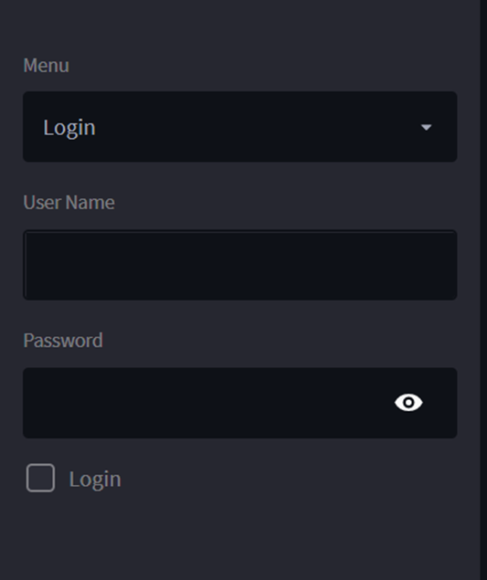
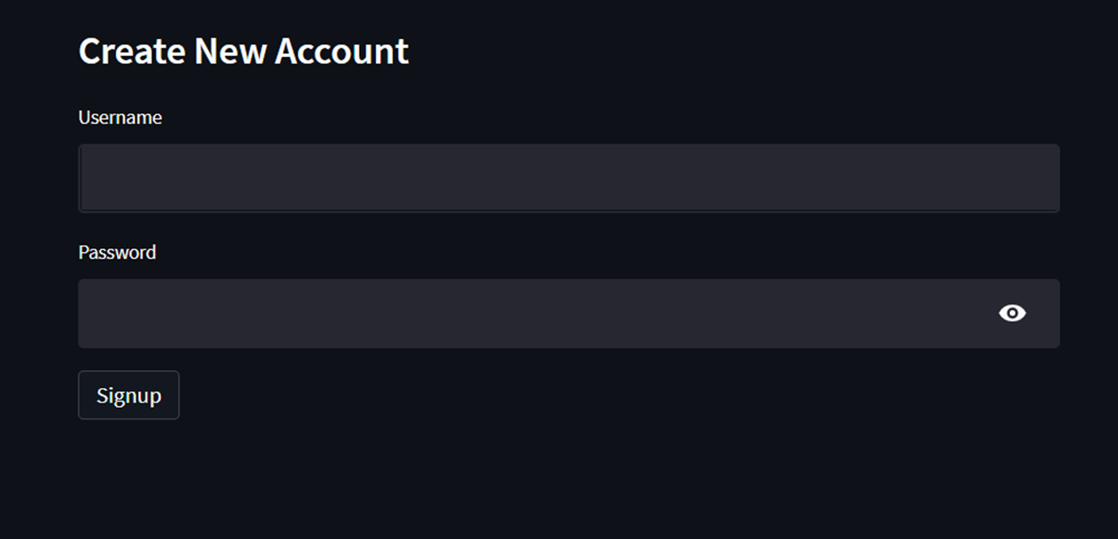
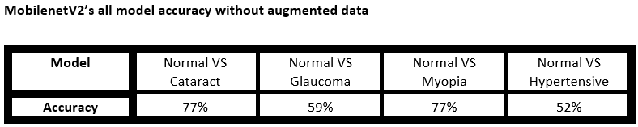
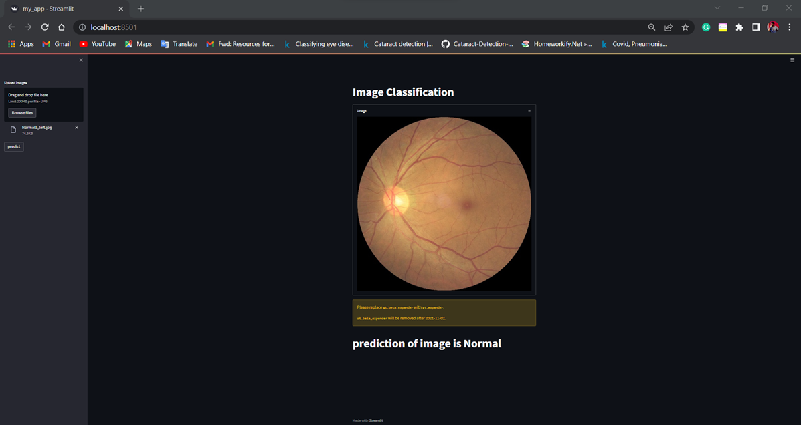
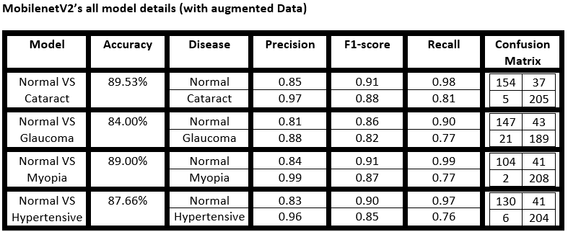
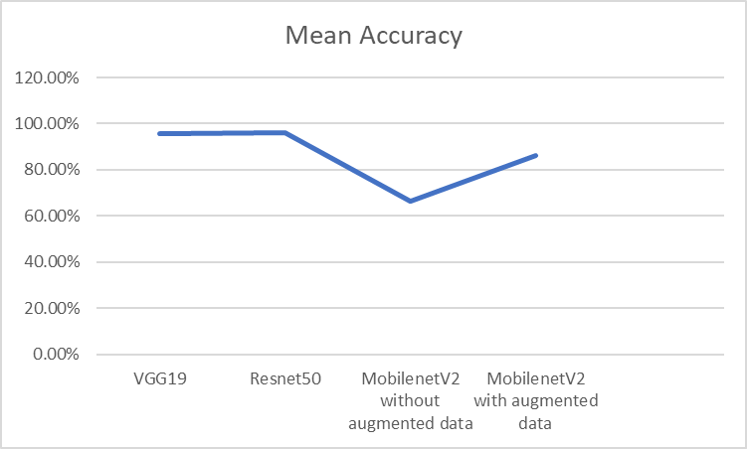
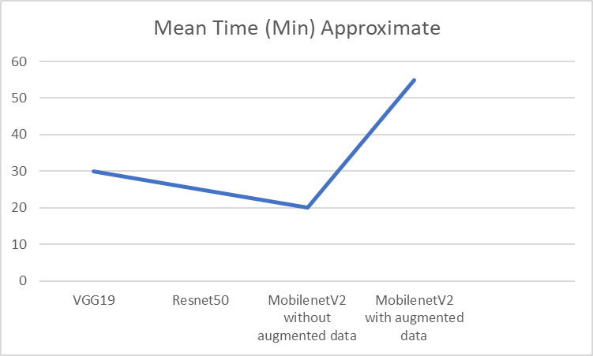
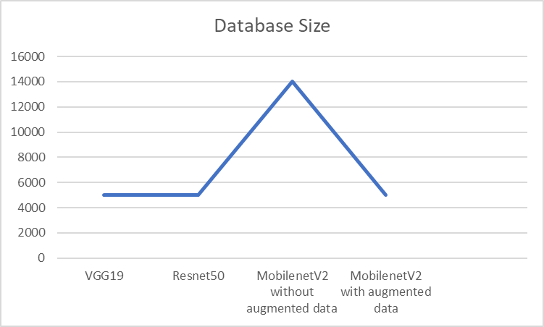

Early detection and identification of eye disorders using fundus pictures is among ophthalmologists' most difficult responsibilities. However, eye illness diagnosis by hand is challenging, time-consuming, and error-prone. For the purpose of employing fundus pictures for early identification of different ocular disorders, a computer-aided automated ocular disease detection system is necessary. Such a system can now be accomplished because to deep learning algorithms' improved picture categorization skills. Four deep learning-based models for pinpointing ocular tumors are presented in this work. For this work, we used the ODIR dataset, which consists of 5000 fundus pictures divided into 4 distinct groups, to train cutting-edge image classification algorithms including Resnet-50, MobileNetV2, and VGG-19.
Ocular Disease Recognition through Deep Learning Architectures
Introduction
Objective
Various ocular diseases are capable of causing permanent and irreversible damage to the patient’s vision, and in extreme cases, they can even lead to blindness [1-3]. Although effective treatments are available for these ocular diseases, these treatment options can only be implemented if the disease is diagnosed as early as possible. Ocular diseases are primarily diagnosed using color fundus photography or CFP [4]. This technique is utilized in order to record the interior surface of the human eye so that various types of possible ocular diseases can be detected [5]. Although this method of diagnosis is effective, it’s still quite difficult to detect certain ocular diseases using CFP. Some of the most prevalent ocular diseases, such as cataracts, myopia, and diabetic retinopathy, are difficult to diagnose as they show very few initial symptoms. [6] Moreover, the process of manually inspecting and detecting ocular diseases is a laborious task, and this process is not that accurate [7]. In recent times, deep learning-based neural network models have shown promising results in medical image classification and object detection. Moreover, that is why convolutional neural network-based models have been extensively studied for ocular disease detection.
In this project, we are using different deep learning algorithms (VGG19, Resnet50, and MobilenetV2) to diagnose different types of ocular diseases (cataract, glaucoma, myopia, and hypertension). The dataset for this project is fundoscopy images. We augmented the dataset for better results. Also, the project is deployed using Stream-lit.
Md Sazid Ahmed Tonmoy
ID: 1911498042
Mail: sazid.Tonmoy@northsouth.edu
Hawlader Md Hadiuzzaman Reaz
ID: 1821940042
Mail: hawlader.reaz@northsouth.edu
Faculty Advisor:
MR. ABU OBAIDAH
Mail: abu.obaidah@northsouth.edu
Methodology
Analysis
There are various types of images of ocular diseases. We chose cataracts, glaucoma, pathological myopia, and hypertensive retinopathy to work with. For each model (VGG19, Resnet50, Mobilenetv2), we tested Normal vs. Cataract, Normal vs. Glaucoma, Normal vs. Myopia, and Normal vs. Hypertension.
Classification Using Resnet50: ResNet50 is a variant of the Resnet model,, which has 48 convolution layers along with 1 MaxPool and 1 Average Pool layer. It has 3.8 x 109 floating point operations. It is a widely used ResNet model, and we have explored the ResNet50 architecture in depth. So as we can see in the resnet 50 architecture contains the following element:
A convolution with a kernel size of 7 * 7 and 64 different kernels all with a stride of size 2 giving us 1 layer.
Next we see max pooling with also a stride size of 2.
In the next convolution there is a 1 * 1,64 kernel following this a 3 * 3,64 kernel and at last a 1 * 1,256 kernel, These three layers are repeated in total 3 time so giving us 9 layers in this step.
Next we see kernel of 1 * 1,128 after that a kernel of 3 * 3,128 and at last a kernel of 1 * 1,512 this step was repeated 4 time so giving us 12 layers in this step.
After that there is a kernal of 1 * 1,256 and two more kernels with 3 * 3,256 and 1 * 1,1024 and this is repeated 6 time giving us a total of 18 layers.
And then again a 1 * 1,512 kernel with two more of 3 * 3,512 and 1 * 1,2048 and this was repeated 3 times giving us a total of 9 layers.
After that we do a average pool and end it with a fully connected layer containing 1000 nodes and at the end a softmax function so this gives us 1 layer.
Classification Using VGG19: A variation of the VGG model called VGG19 has 19 layers in total (16 convolution layers, 3 Fully connected layer, 5 MaxPool layers and 1 SoftMax layer). There are further VGG variations, including VGG11, VGG16, and others. 19.6 billion FLOPs make up VGG19. So as we can see in the VGG19architecture contains the following element:
A fixed size of (224 * 224) RGB image was given as input to this network which means that the matrix was of shape (224,224,3).
The only preprocessing that was done is that they subtracted the mean RGB value from each pixel, computed over the whole training set.
Used kernels of (3 * 3) size with a stride size of 1 pixel, this enabled them to cover the whole notion of the image.
spatial padding was used to preserve the spatial resolution of the image.
max pooling was performed over a 2 * 2 pixel windows with sride 2.
this was followed by Rectified linear unit(ReLu) to introduce non-linearity to make the model classify better and to improve computational time as the previous models used tanh or sigmoid functions this proved much better than those.
implemented three fully connected layers from which first two were of size 4096 and after that a layer with 1000 channels for 1000-way ILSVRC classification and the final layer is a softmax function.
Classification Using MobilenetV2:We have explored MobileNet V2 architecture in depth. MobileNet V2 model has 53 convolution layers and 1 AvgPool with nearly 350 GFLOP. It has two main components:
Bottleneck Residual Block
Inverted Residual Block
There are two types of Convolution layers in MobileNet V2 architecture:
1x1 Convolution
3x3 Depth wise Convolution
We take 100 epoch for every model. We resize every images 224*224. We also did use some function for time reduction. EarlyStopping class stops training when a monitored metric has stopped improving. ReduceLROnPlateau class reduces learning rate when a metric has stopped improving.
We will be analyze our model by there accuracy. Based on the input, or training, data, machine learning model accuracy is the statistic used to discover which model is best at recognizing correlations and patterns between variables in a dataset. The better predictions and insights a model can generate, which in turn provide more commercial value, depend on how well it can generalize to "unseen" data.
VGG 19: Using VGG-19, the accuracy of cataract vs. normal original data is 97.24%. Glaucoma vs. normal has an accuracy of 90.94%. In addition, myopia vs. normal has an accuracy of 98.13%. The accuracy for hypertensive vs. normal is 94.73%. It has no overriding issue. It performed very well. We removed bias by balancing images for data classes.
Resnet50: Resnet50 is the best performed model according to accuracy. Using Resnet50, the accuracy of cataract vs. normal original data is 99.45%. Glaucoma vs. normal has an accuracy of 90.98%. In addition, myopia vs. normal has an accuracy of 99.26%. The accuracy for hypertensive vs. normal is 94.73%. It has no overriding issue. It performed very well. We removed bias by balancing images for data classes.
MobilenetV2: It is the worst performed model out of three. The result without augmented data is too bad. But after taking augmented data, we did get satisfactory results form this model.
Cataract V Normal original data Using MobilenetV2 has 77% accuracy
Cataract V Normal augmented data Using MobilenetV2 has 90% accuracy
Glaucoma V Normal original data Using MobilenetV2 has 59% accuracy
Glaucoma V Normal augmented data Using MobilenetV2 has 84% accuracy
Myopia V Normal original data Using MobilenetV2 has 77% accuracy
Myopia V Normal augmented data Using MobilenetV2 has 89% accuracy
Hypertensive V Normal original data Using MobilenetV2 has 52% accuracy
Hypertensive V Normal augmented data Using MobilenetV2 has 88% accuracy
we can see in the training performance of MobileNetV2, its accuracy is getting improved and it can be inferred that the accuracy will certainly be improved if we run the training for more number of epochs. Also, There is hundred percentage training accuracy issue on VGG19 and Resnet50. We had tried to train those model in various dataset split ratio. There were various issue, but we selected the most optimized one. When we got hundred percentage training accuracy, we looked the accuracy of the model and the curve. If training accuracy curve is above validation curve and the accuracy was the highest, we recorded necessary information. But There is no hundred percent training accuracy issue on MobilenetV2. So, there is no overfitting issue also.
Deployment
A Python-based open source app framework is called Streamlit. It enables us to quickly develop web applications for data science and machine learning. Major Python libraries like scikit-learn, Keras, PyTorch, SymPy (latex), NumPy, pandas, and Matplotlib are all compatible with it. We used Streamlit to deploy our project.
We use Sqlite3 for temporary Data Management. Python SQLite3 module is used to integrate the SQLite database with Python. It is a standardized Python DBI API 2.0 and provides a straightforward and simple-to-use interface for interacting with SQLite databases. There is no need to install this module separately as it comes along with Python after the 2.5x version.
Dataset
We used the Ocular Disease Intelligent Recognition (ODIR) dataset for this investigation. One of the largest multiclass eye illness detection datasets that is openly accessible in the entire world. By gathering fundus photos from several hospitals in China, Shanggong Medical Technology Co, Ltd created this dataset. This dataset's fundus photos are divided into eight distinct groups for eye diseases. There are seven disease classifications in these categories: diabetes (D), cataract (C), glaucoma (G), age-related muscle degeneration (A), myopia (M), hypertension (H), and other abnormalities/diseases (O). The 5000 examples of color fundus photos (CFPs) in this dataset are divided into training and testing subsets. Only normal, cataract, glaucoma, myopia, and hypertension were utilized (H). We then use augmentation to get more accuracy for mobilenetv2 model.
Conclusion
Evaluation of the model
In this study, we created four neural network-based models for classifying eye diseases. These models are VGG-19, Resnet-50, and MobileNetV2. When it comes to categorizing ocular disorders from fundus pictures, the Resnet50 offered the best accuracy for all models. The other models' performance was similarly acceptable. To verify the efficacy of our suggested strategy, we conducted extensive tests using the ODIR- 2019 dataset, which is open to the general public. In comparison to the current CNN-based ocular illness classification models, our suggested technique can produce results that are more spectacular while using less computing power. The nicest thing about our suggested approach is how easy it may be applied to various kinds of illness categorization based on medical images. Furthermore, a user-friendly, real-time system for classifying ocular illnesses may be created using the models reported in this paper. Such a method will change the area of visual illness diagnostics and be of enormous use to medical experts.
Precision and recall are two metrics used to evaluate classification and retrieval systems' performance. Precision is the percentage of relevant occurrences among all retrieved examples. Recall, also known as sensitivity, is the percentage of recovered instances among all appropriate models. In a perfect classifier, precision and recall are both one. Object detection models like YOLO use the assessment measure mAP (mean Average Precision). To calculate mAP, we needed IOU, Precision, Recall, Precision Recall Curve, and AP. The confidence threshold was used to calculate the mAP.
Definition for mAP (mean average precision)
$$recall=\frac{retrieved and relevant objects}{all retrieved objects}=\frac{Tp}{Tp+Fp}$$
$$precision=\frac{retrieved and relevant objects}{all retrieved objects}= \frac{Tp}{Tp+Fp}$$
$$average precision AP= \sum_{k=0}^{k=n−1}{\left[Recall\left(k\right)−Recall\left(k+1\right)∗Precision\left(k\right)\right]}$$
$$mAP=\frac{1}{n} \sum_{k=1}^{k=n}{AP}(k)$$
Where AP_{K} = the AP of class k
n = number of classes
Reference
[1] Bourne, R. R., Stevens, G. A., White, R. A., Smith, J. L., Flaxman, S. R., Price, H., Jonas, J. B., Keeffe, J., Leasher, J., Naidoo, K., Pesudovs, K., Resnikoff, S., & Taylor, H. R. (2013). Causes of vision loss worldwide, 1990–2010: a systematic analysis. The Lancet Global Health, 1(6). https://doi.org/10.1016/s2214-109x(13)70113-x
[2] Sommer, A., Tielsch, J. M., Katz, J., Quigley, H. A., Gottsch, J. D., Javitt, J. C., Martone, J. F., Royall, R. M., Witt, K. A., & Ezrine, S. (1991). Racial Differences in the Cause-Specific Prevalence of Blindness in East Baltimore. New England Journal of Medicine, 325(20), 1412–1417. https://doi.org/10.1056/nejm199111143252004
[3] Congdon, N., O'Colmain, B., Klaver, C. C., Klein, R., Muñoz, B., Friedman, D. S., Kempen, J., Taylor, H. R., Mitchell, P., & Eye Diseases Prevalence Research Group (2004). Causes and prevalence of visual impairment among adults in the United States. Archives of ophthalmology (Chicago, Ill. : 1960), 122(4), 477–485.
[4] Application of Ocular Fundus Photography and Angiography. (2014). Ophthalmological Imaging and Applications, 154–175. https://doi.org/10.1201/b17026-12
[5] Rowe, S., MacLean, C. H., & Shekelle, P. G. (2004). Preventing Visual Loss From Chronic Eye Disease in Primary Care. JAMA, 291(12), 1487. https://doi.org/10.1001/jama.291.12.1487
[6] Kessel, L., Erngaard, D., Flesner, P., Andresen, J., Tendal, B., & Hjortdal, J. (2015). Cataract surgery and age‐related macular degeneration. An evidence‐based update. Acta Ophthalmologica, 93(7), 593–600. https://doi.org/10.1111/aos.12665Li, N., Li, T., Hu, C., Wang, K.
[7] Li, N., Li, T., Hu, C., Wang, K., & Kang, H. (2021). A Benchmark of Ocular Disease Intelligent Recognition: One Shot for Multi-disease Detection. Benchmarking, Measuring, and Optimizing, 177–193. https://doi.org/10.1007/978-3-030-71058-3_11

